Slide 1
Basic Electronics
EEE Lecture 3

Slide 2
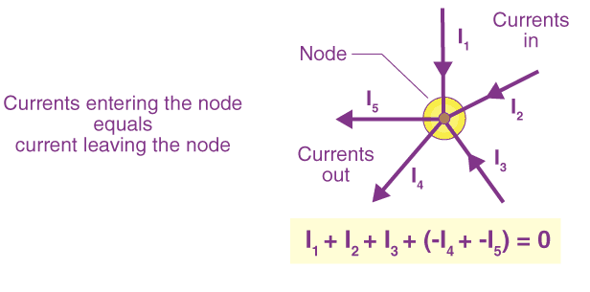
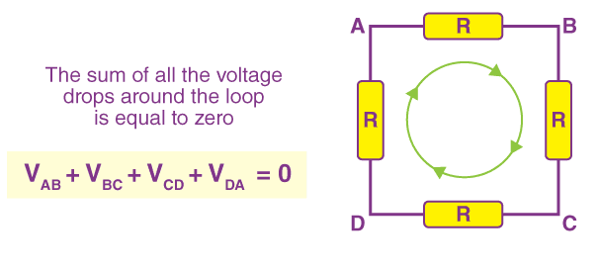
Voltage, Current, Kirchoff’s Laws
Covered last week
For those who can’t attend, reach out after this lecture
Kirchoff Current Law
Kirchoff Voltage Law

Slide 3
Terms
Electronic Components All the devices that we are talking about
Analog Electronics Study of analog signals and devices operating on them. What we’ll discuss today
Digital Electronics Study of discrete signals and devices operating on them. Not discussed today

Slide 4
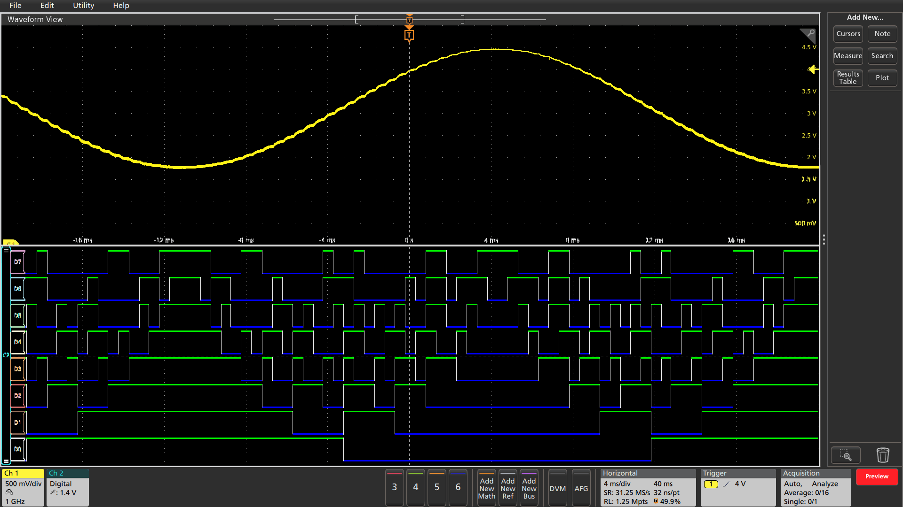
Analog Signal
Digital Signal

Slide 5
Must-know Components

Slide 6
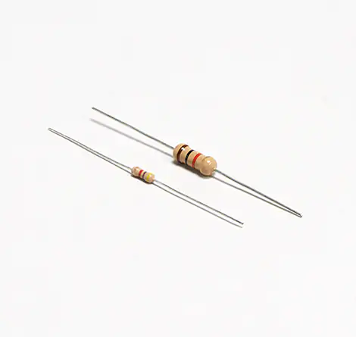
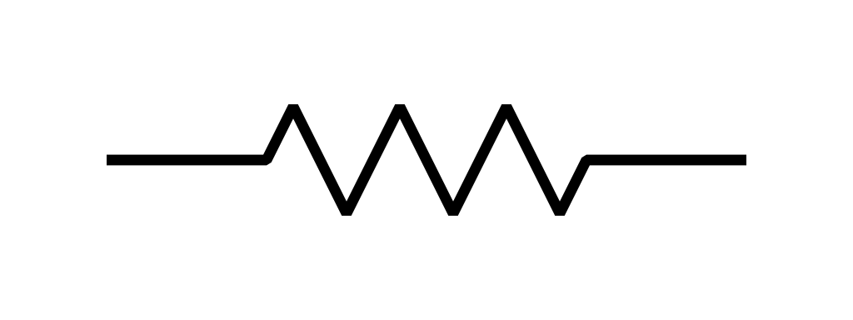
Resistor
Some conducting stuff (carbon, thin metal, carbon film) with a wire at each end

Slide 7
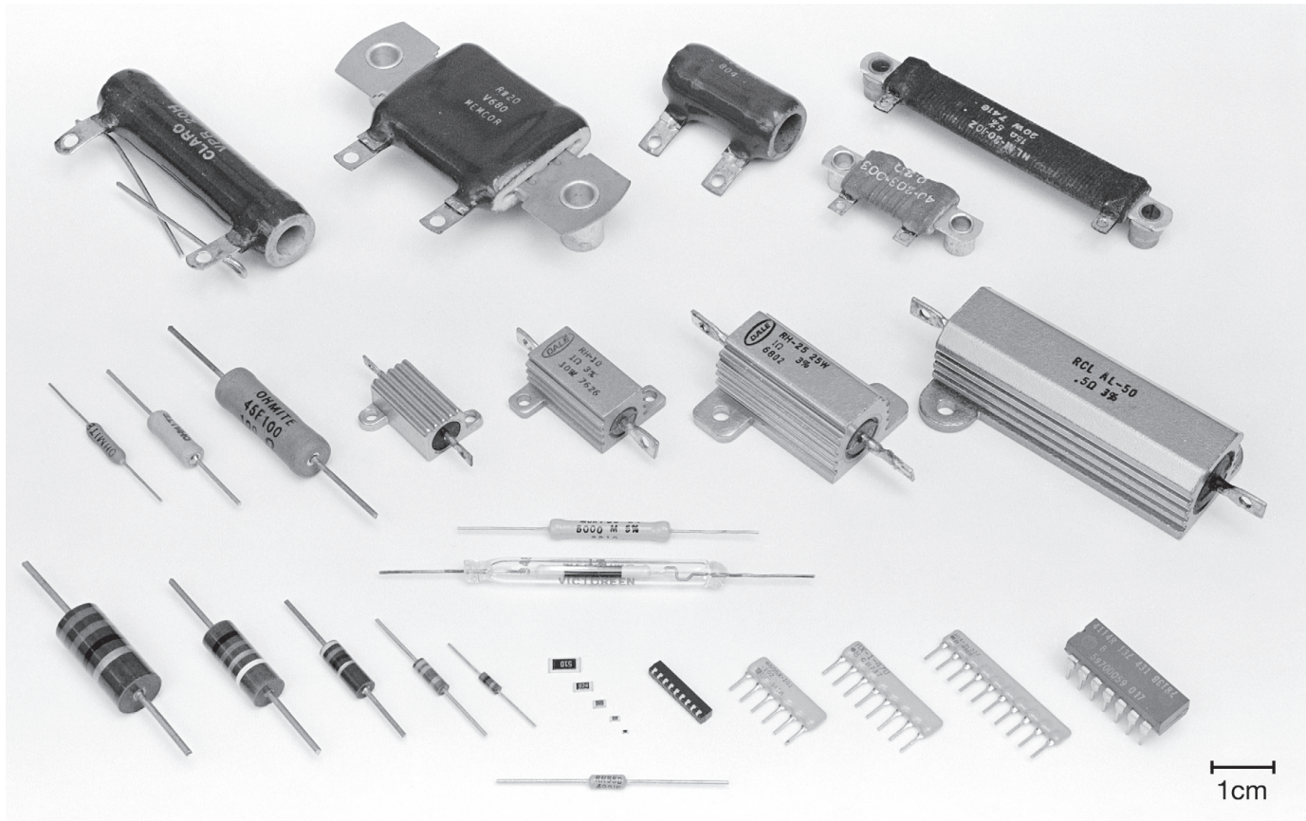
Resistor - Types

Slide 8
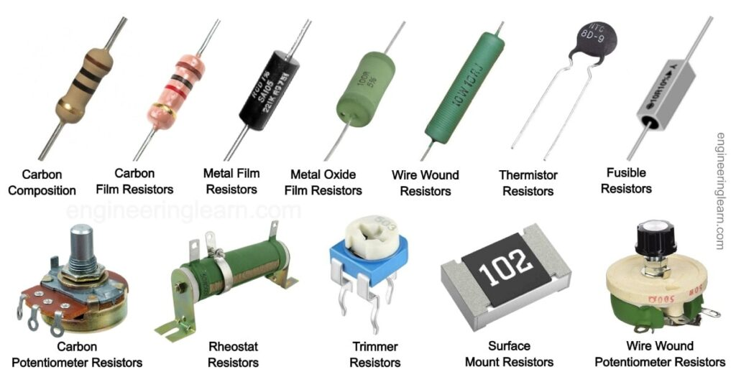
Resistor - Types

Slide 9
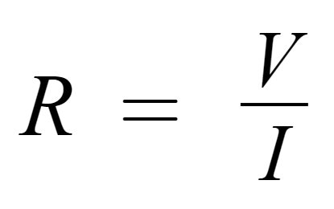
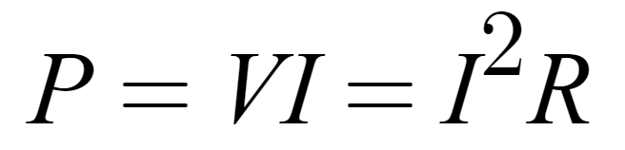
Resistor - Ohm’s Law and Power
Voltage across it is related to the current through it by a resistance R.
Ohm’s Law
Power Dissipated

Slide 10
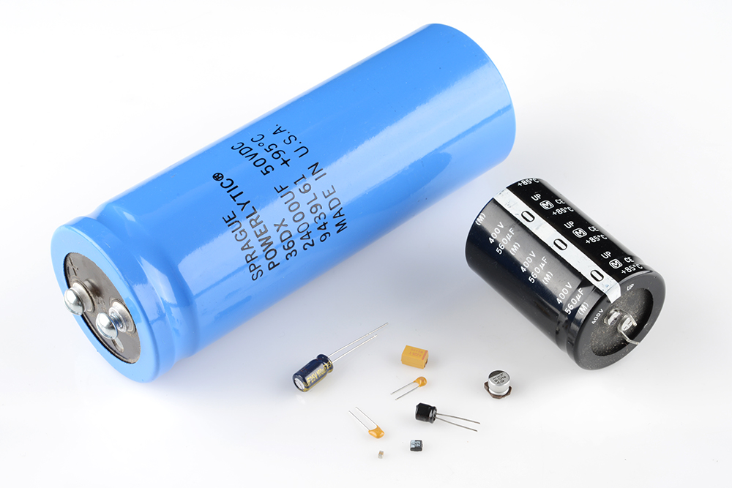
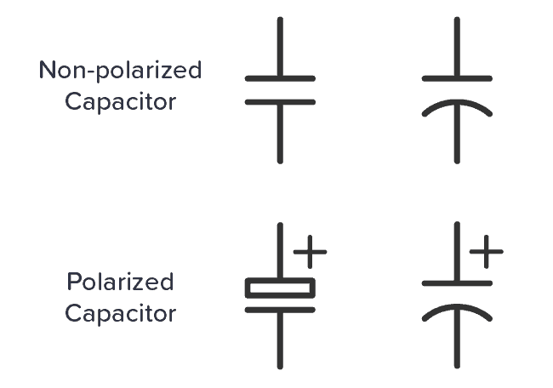
Capacitor
Devices that store charge between plates (or dielectrics) separated by an insulating material.

Slide 11
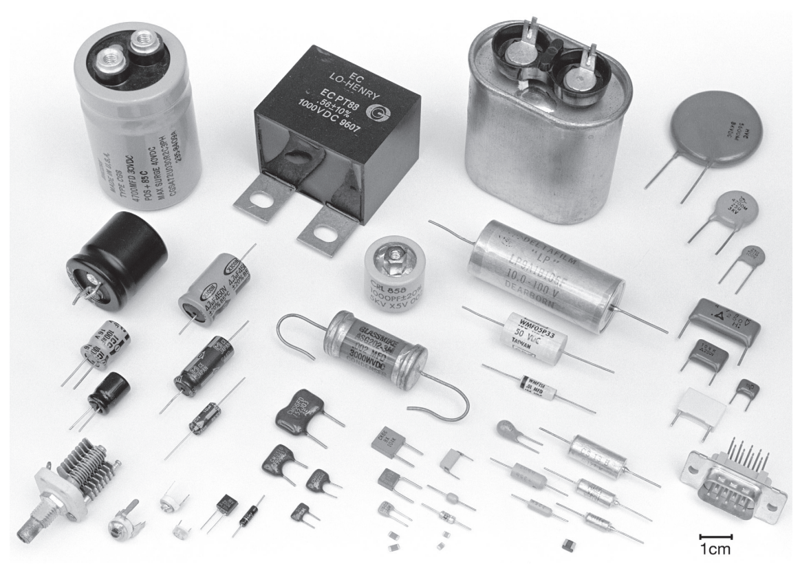
Capacitor - Types

Slide 12
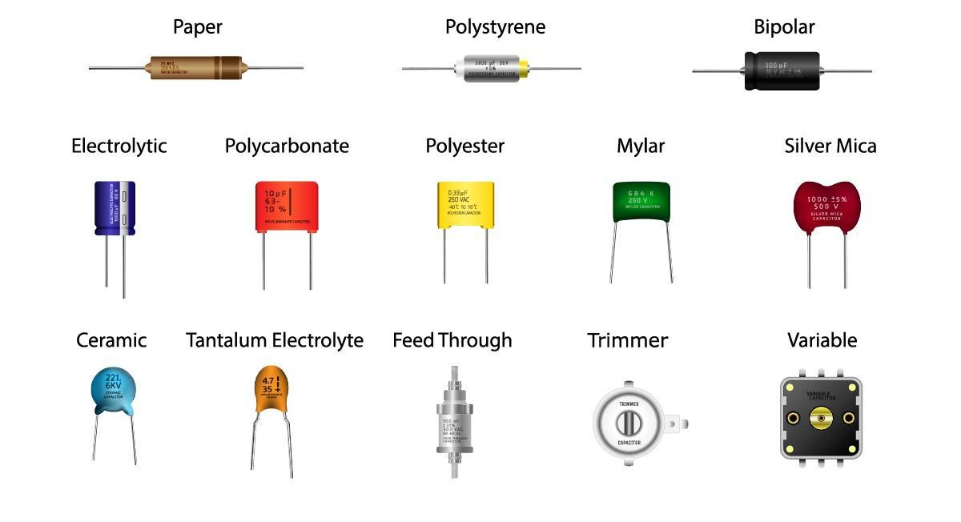
Capacitor - Types

Slide 13
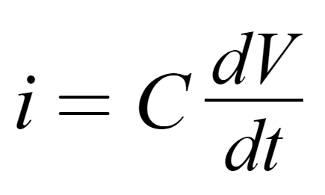
Capacitor - Equations
Rate of change of voltage across it is related to the current through it by a capacitance C.

Slide 14
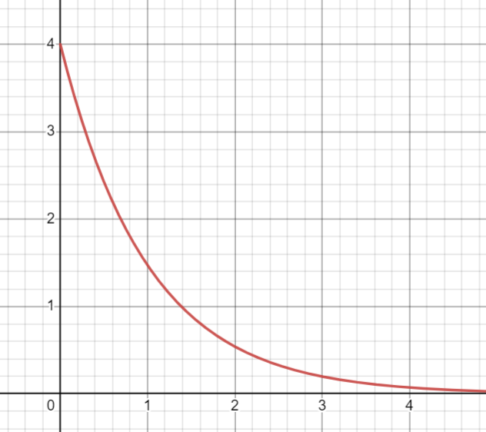
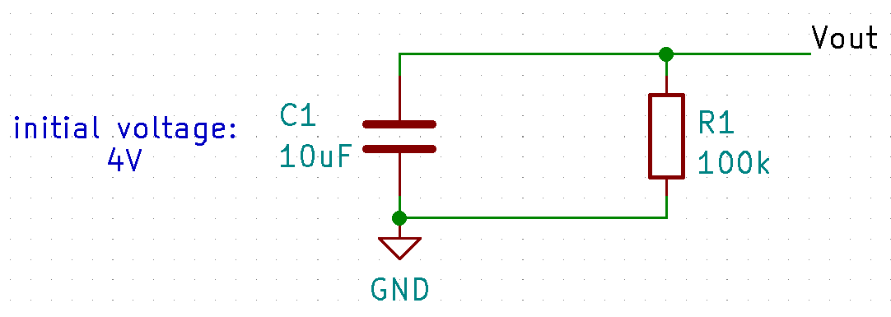
Capacitor - RC Circuit
A charged capacitor across a resistor will discharge the voltage (and dissipate power)
Vout / V
t / s

Slide 15
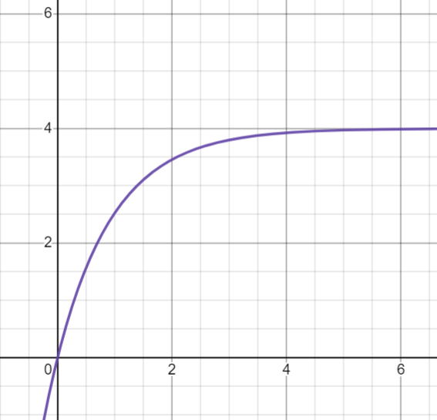
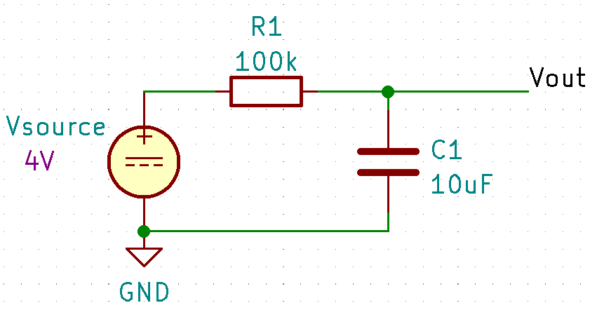
Capacitor - RC Circuit
A voltage source across an uncharged capacitor will charge; voltage across cap will slowly approach source.
Vout / V
t / s

Slide 16
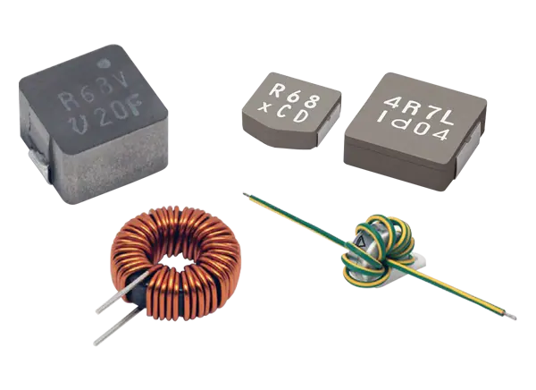
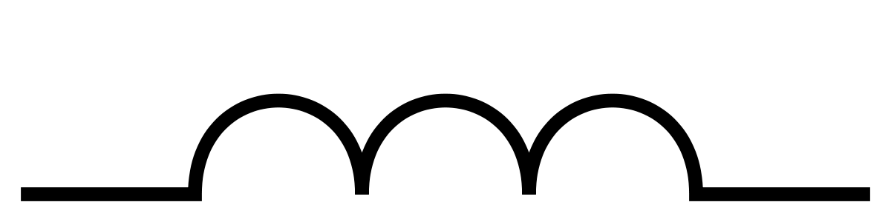
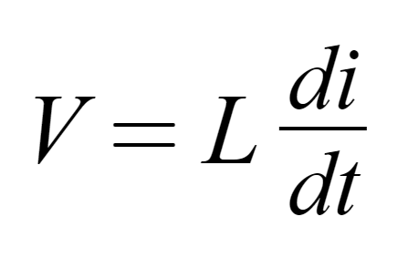
Inductor
Similar to capacitor but rate of change of current is related to voltage through an inductance.

Slide 17
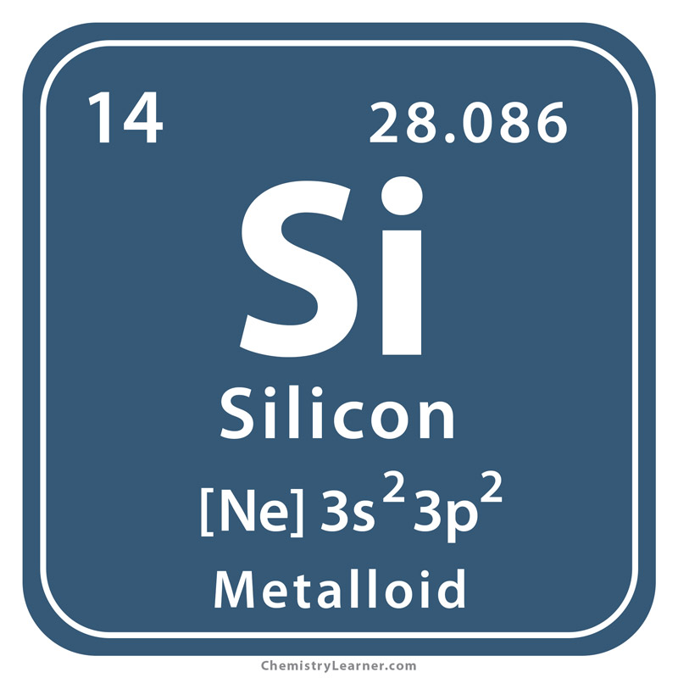
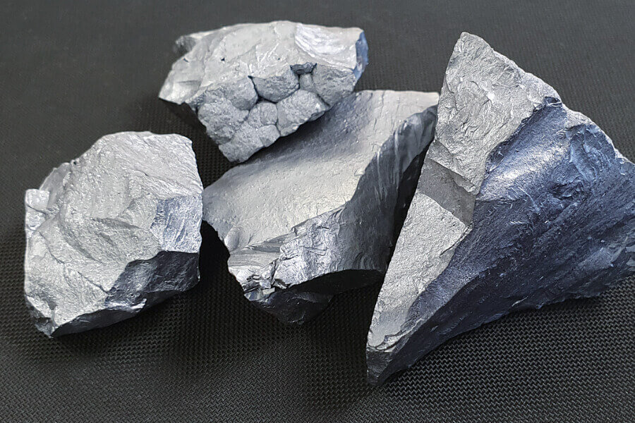
Semiconductor
A material that could change its conductivity, behaving both like an insulator and a conductor

Slide 18
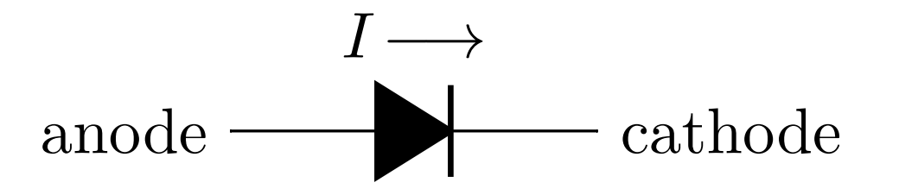
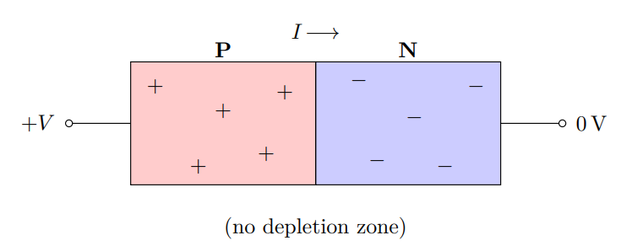
Diode
A simple semiconductor device that allows current to only flow in one direction

Slide 19
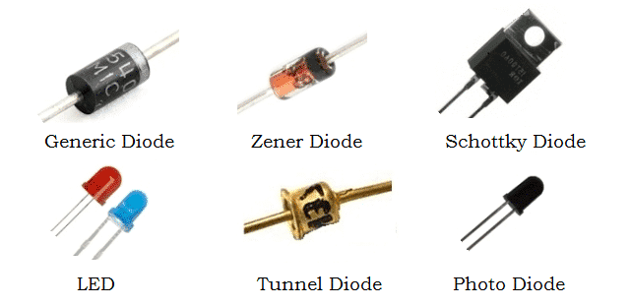
Diode - Types

Slide 20
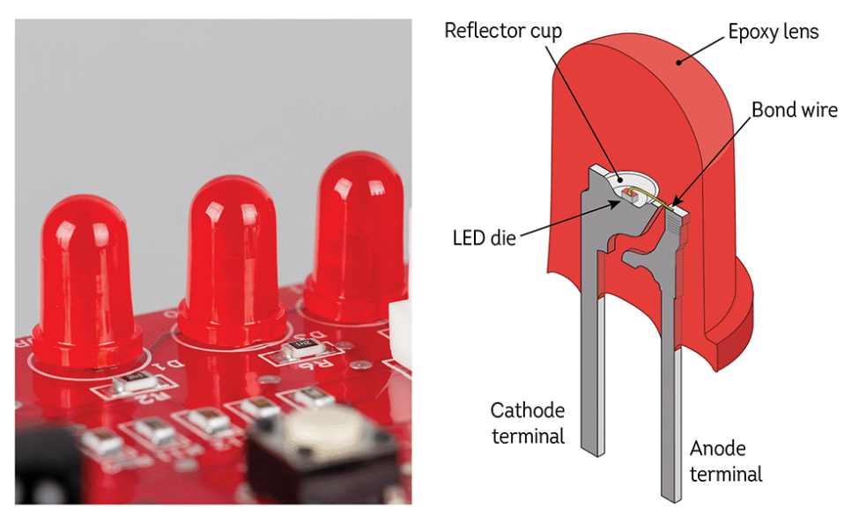
Diode - LEDs
Basically a diode with larger power requirements

Slide 21
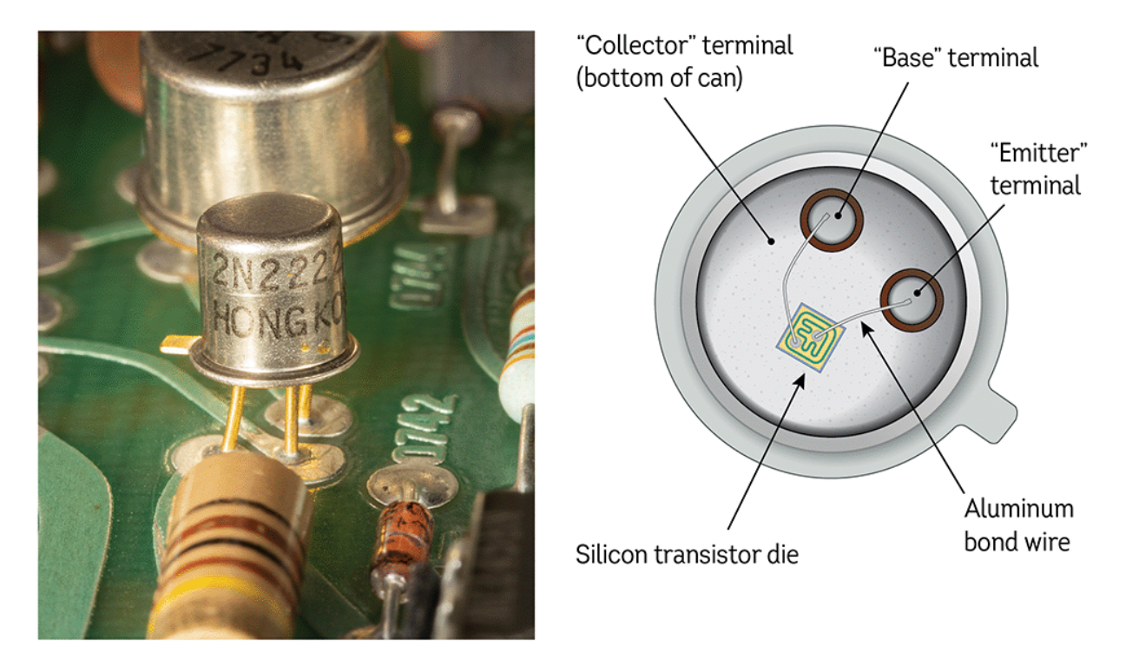
Transistor
A three-terminal device that allows one electrical signal to control another
Notes:
TO-18 Package 2N2222 BJT

Slide 22
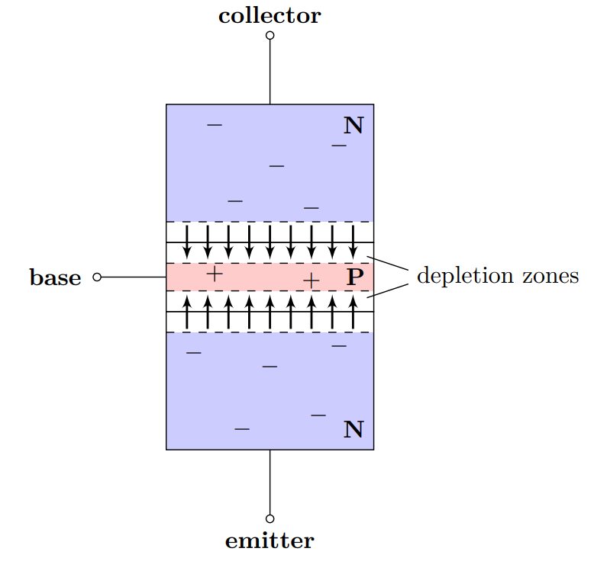
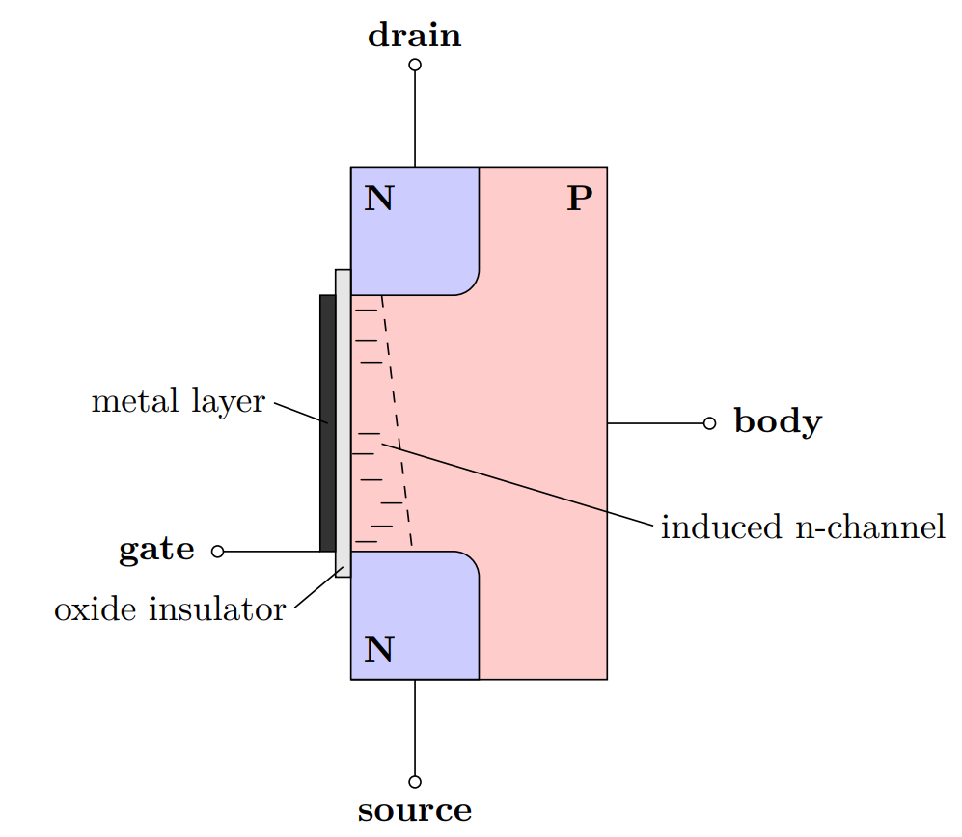
Transistor - Construction
This control is done using doped semiconductor materials, in different constructions
Bipolar Junction Transistor
Field-Effect Transistor
Notes:
TO-18 Package 2N2222 BJT

Slide 23
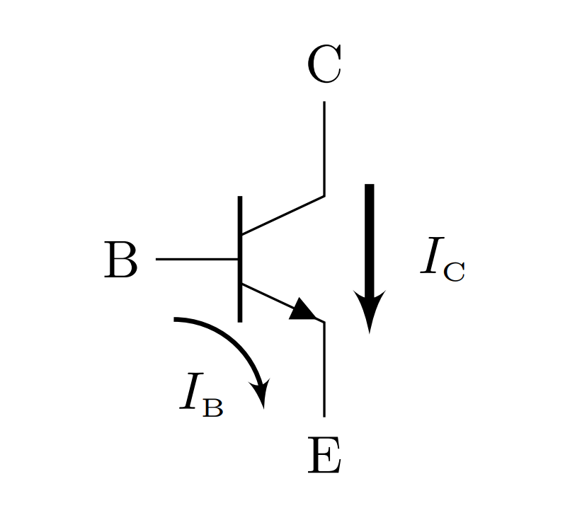
BJT - Bipolar Junction Transistor
A transistor that uses the base current I_B to program/control the collector current I_C

Slide 24
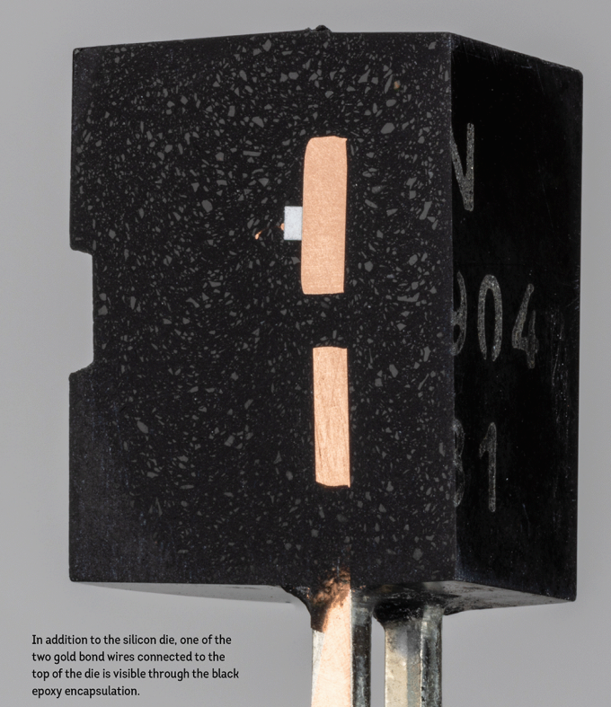
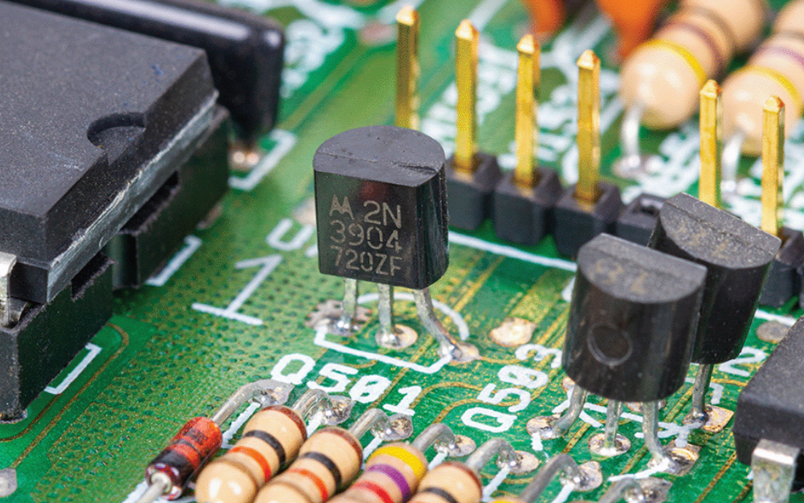
BJT - Anatomy
Pins/Terminals

Slide 25
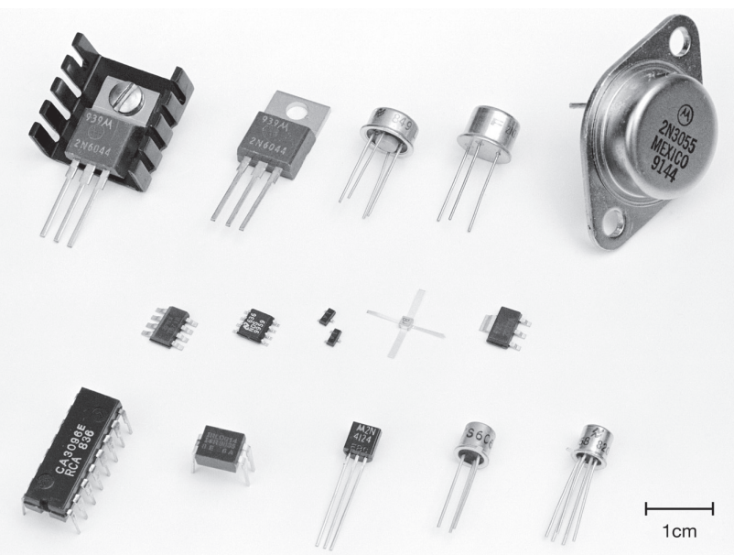
BJT - Packages

Slide 26
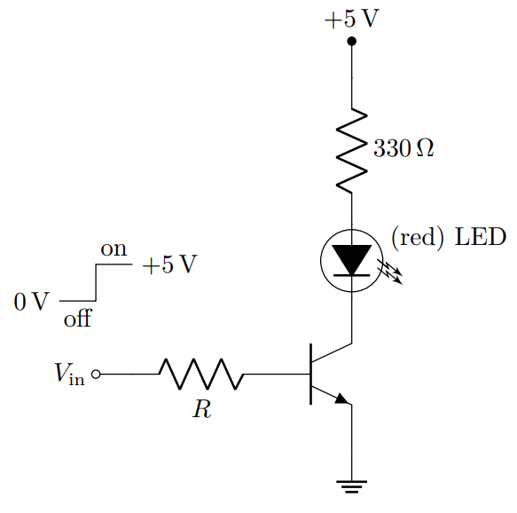
BJT - Switch

Slide 27
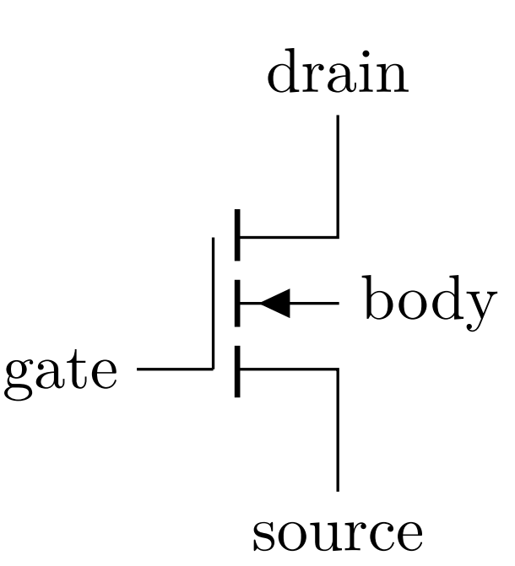
MOSFET
Another type of transistor. This time, it uses voltage to control the current. More specifically, the Gate-Source voltage V_GS controls/programs the drain current I_d
I_d
V_GS

Slide 28
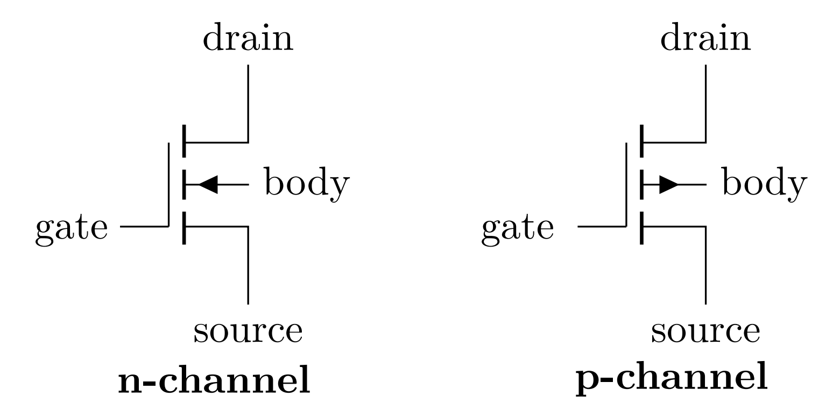
MOSFET - Types

Slide 29
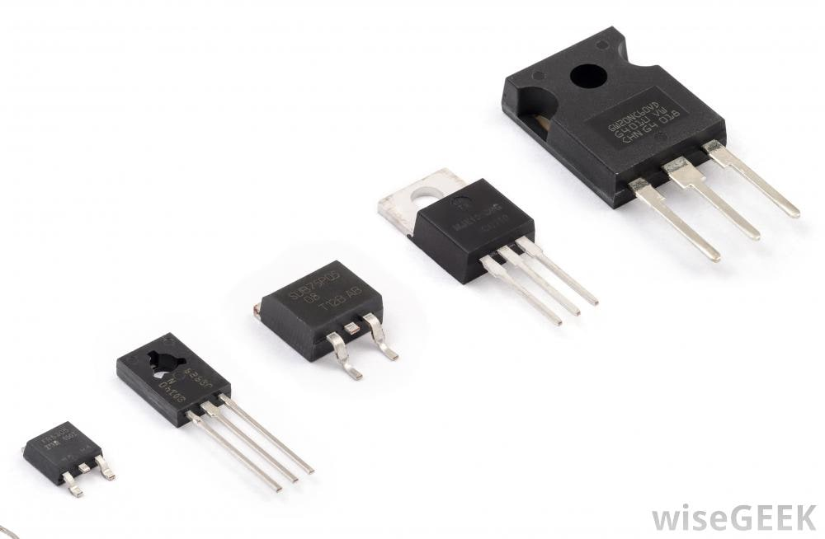
MOSFET - Packages

Slide 30
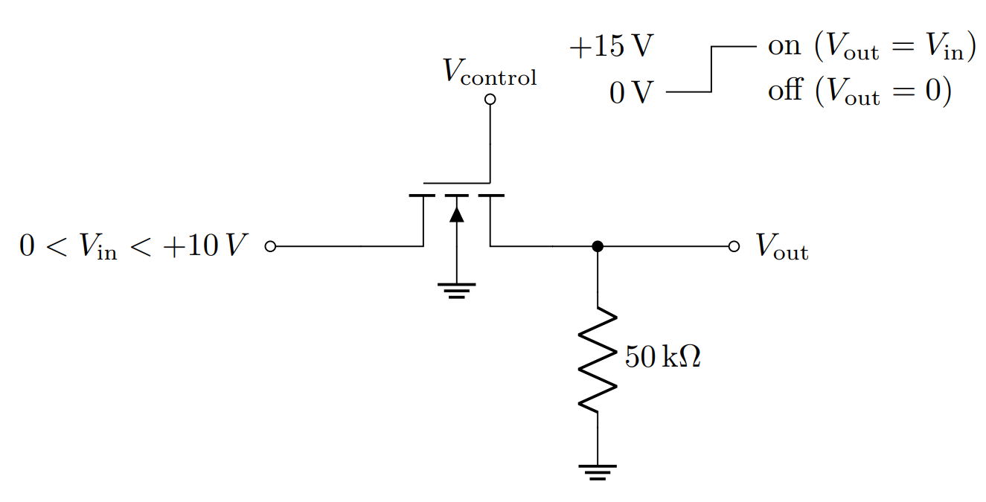
MOSFET - Switch

Slide 31
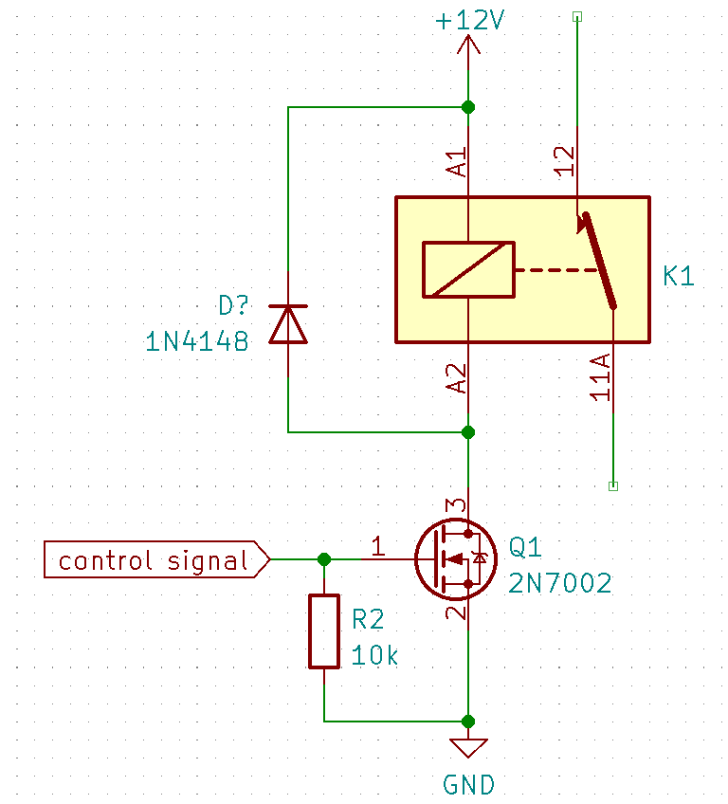
MOSFET Relay Driver
Similar to driving an LED

Slide 32
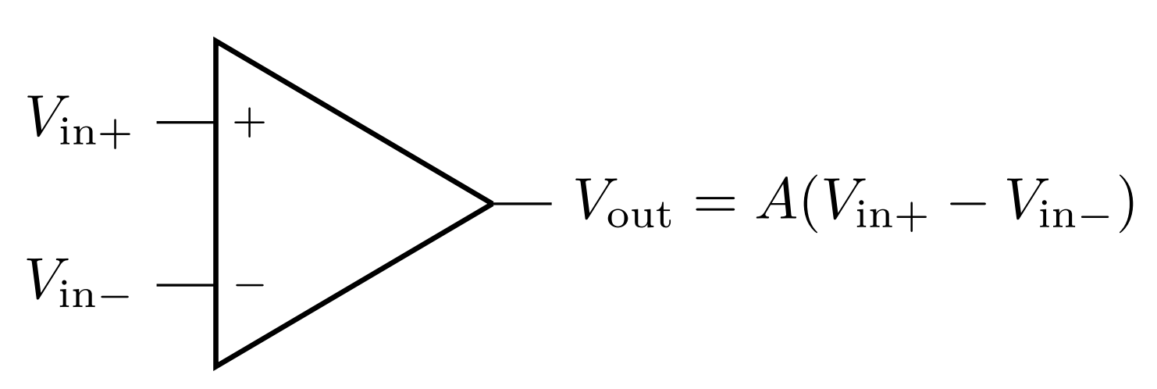
Op Amp - Operational Amplifier
A high-gain voltage amplifier that takes 2 inputs and has 1 output (single-ended output).
Notes:
The operational amplifier is a very high-gain dc-coupled differential amplifier with a single-ended output
Using the words “non-inverting” and “inverting,” rather than “plus” and “minus” helps avoid confusion.
Power-supply connections are frequently not displayed

Slide 33
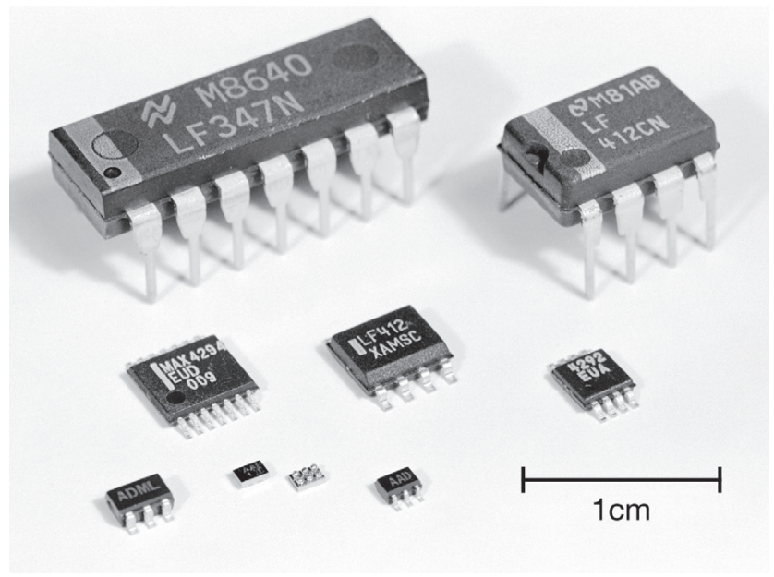
Op Amp - Packages

Slide 34
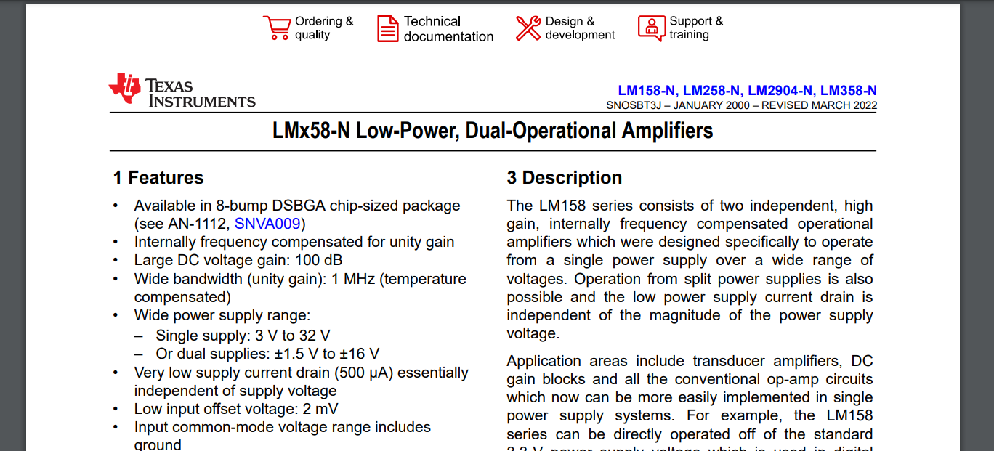
Op Amp - Example (LM358 Datasheet)
https://www.ti.com/lit/ds/snosbt3j/snosbt3j.pdf

Slide 35
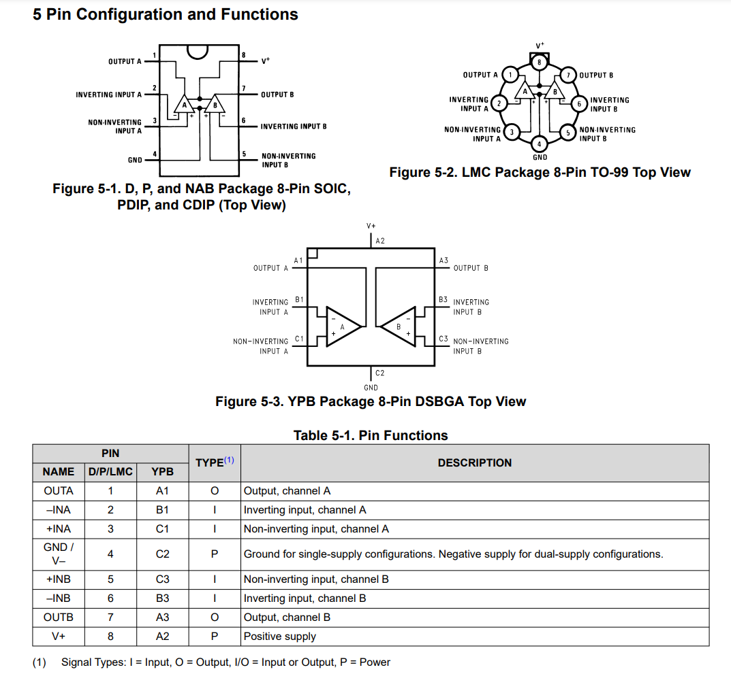
Op Amp - LM358
What to look at - Pinouts
Note that this is two op-amps in a single chip, so all the pins are doubled

Slide 36
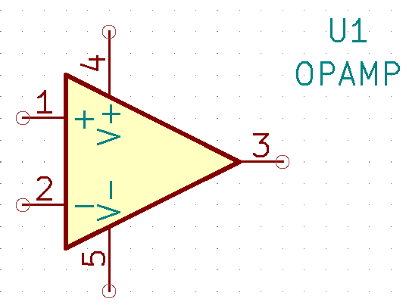
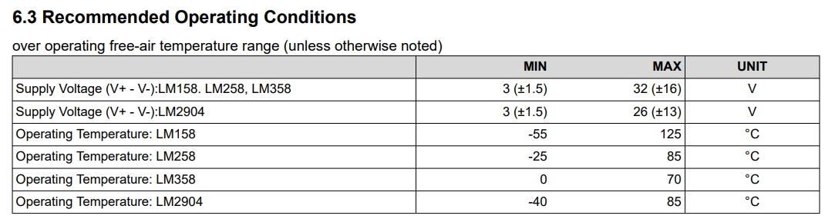
Op Amp - Example (LM358 Datasheet)
What to look at - Supply Voltage

Slide 37
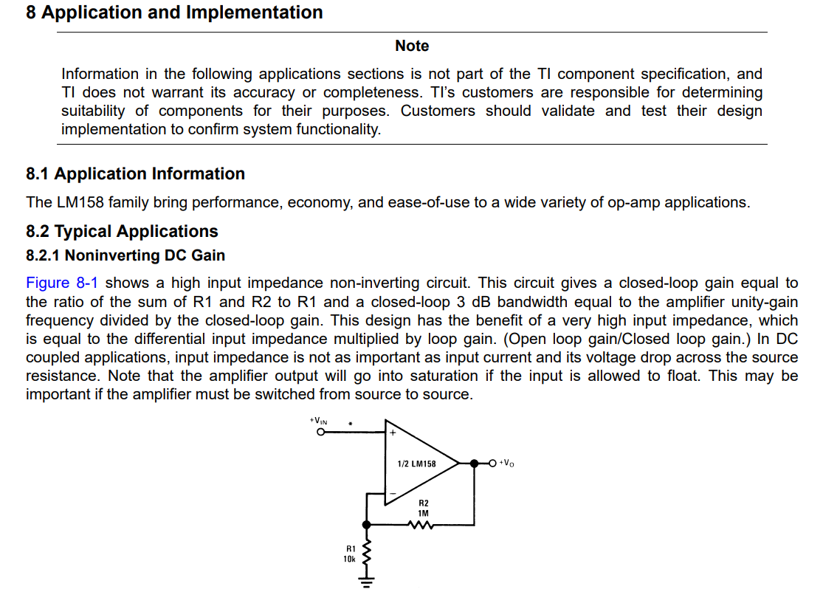
Op Amp - Example (LM358 Datasheet)
What to look at - Implementation

Slide 38
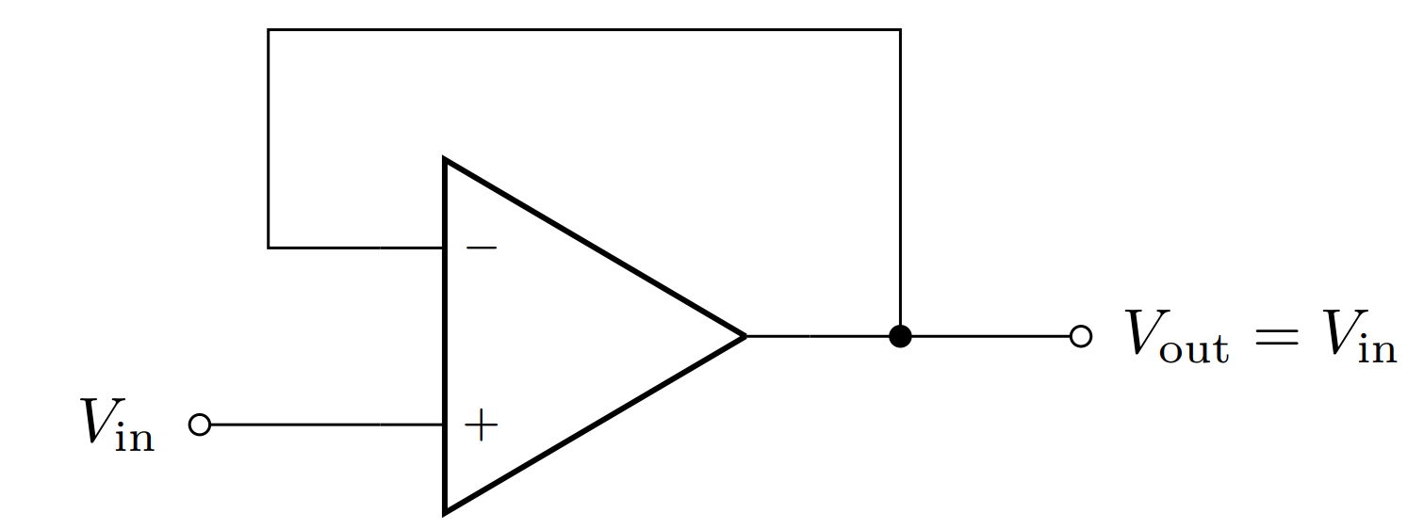
Op Amp - Voltage Buffer
Let’s you have desirable characteristics (high input impedance & low output impedance) when stitching/connecting circuits together

Slide 39
Miscellaneous Components

Slide 40
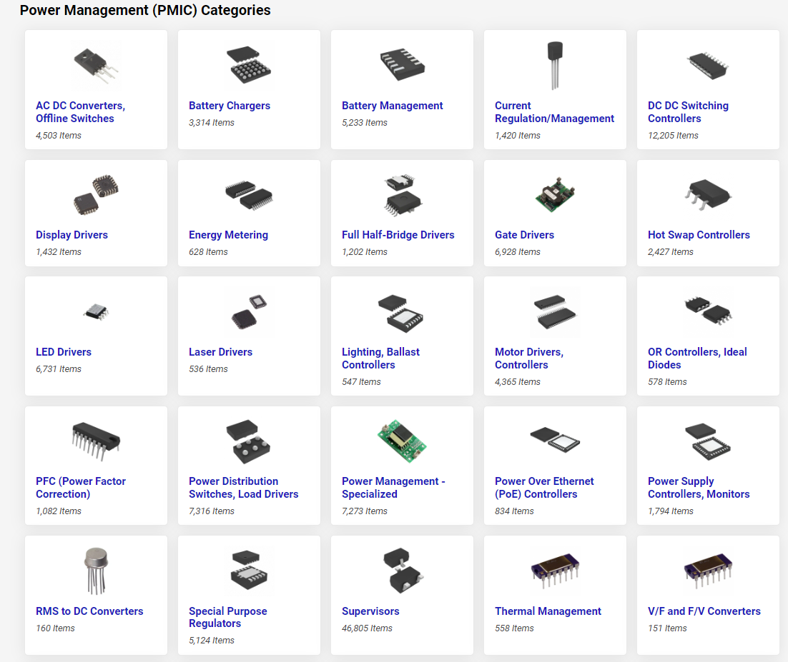
Power Management IC
Achieves functions related to power requirement:
Examples:
Voltage conversion
Voltage regulation
Battery management
Battery charging

Slide 41
The End

